Slide 1
CSC431 OBJECT ORIENTED PROGRAMMING USING JAVA Unit 3

Slide 2
Access Modifiers
Access modifiers are the keywords that set the accessibility (visibility) of classes, variables and methods to control their level of access.
Java has four access modifiers:
Default : When no access modifier is specified, it is treated as default modifier.
Its scope is limited within the package.
Public: The word itself indicates that it has scope everywhere, It is visible everywhere even outside the package.
Private: It has scope only within the class
Protected : Its scope limits within the package and all sub classes.

Slide 3
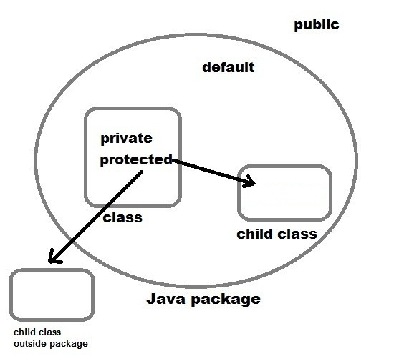

Slide 4
Method Overriding
Overriding is a feature that allows a subclass or child class to provide a specific implementation of a method that is already provided by one of its super-classes or parent classes.
When a method in a subclass has the same name, same parameters or signature and same return type as a method in its super-class, then the method in the subclass is said to override the method in the super-class.

Slide 5
Rules
Final methods can not be overridden
Static methods can not be overridden
Private methods can not be overridden
The overriding method must have same return type

Slide 6
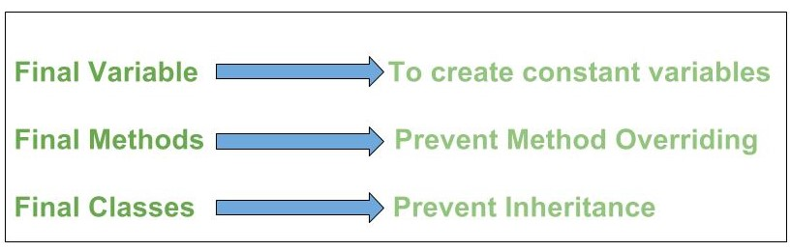
Final Keyword
final is a non-access modifier applicable only to a variable, a method or a class.

Slide 7
Wrapper Classes in Java
A Wrapper class is a class whose object wraps or contains a primitive data types.
When we create an object to a wrapper class, it contains a field and in this field, we can store a primitive data types.
In other words, we can wrap a primitive value into a wrapper class object.

Slide 8
They convert primitive data types into objects
The classes in java.util package handles only objects and hence wrapper classes help in this case also.
Data structures in the Collection framework, such as ArrayList and Vector, store only objects (reference types) and not primitive types.
An object is needed to support synchronization in multithreading.

Slide 9
Primitive | Wrapper Class | Constructor Argument
boolean | Boolean | boolean or String
byte | Byte | byte or String
char | Character | char
int | Integer | int or String
float | Float | float, double or String
double | Double | double or String
long | Long | long or String
short | Short | short or String

Slide 10
Autoboxing
Automatic conversion of primitive types to the object of their corresponding wrapper classes is known as autoboxing
For example – conversion of int to Integer, long to Long, double to Double etc.

Slide 11
Unboxing
It is just the reverse process of autoboxing.
Automatically converting an object of a wrapper class to its corresponding primitive type is known as unboxing.
For example – conversion of Integer to int, Long to long, Double to double etc.

Slide 12
Wrapper Methods
valueOf()
xxxValue()
parseXxx()
toString()

Slide 13
class wrap
{
public static void main(String[] args)
{
Integer I = Integer.valueOf(10);//I=10
Integer I = Integer.valueOf("1111", 2);//I=15
Integer I = Integer.valueOf("10");// I=10
Integer I = new Integer(130);
int n=I.intValue();
System.out.println(n); //n=130

Slide 14
String s=“12”;
int k=Integer.parseInt(s)
System.out.println(k);
int i = Integer.parseInt("1000", 2);
System.out.println(i);//8

Slide 15
int m=14;
String s2=Integer.toString(m);
System.out.println(s2);
String s = Integer.toString(6, 2); //110
System.out.println(s);
String s1 = Long.toString(11, 16); //b
System.out.println(s1);

Slide 16
Integer z=new Integer(100);
int z1=z; //Unboxing
System.out.println(z1);
Integer z2;
z2=z1; //Autoboxing
System.out.println(z2.intValue());

Slide 17
Write a Java program
Return the size of the largest mirror section found in the given array.
A "mirror" section in an array is a group of contiguous elements such that somewhere in the array, the same group appears in reverse order
maxMirror([1, 2, 3, 8, 9, 3, 2, 1]) → 3 maxMirror([1, 2, 1, 4]) → 3 maxMirror([7, 1, 2, 9, 7, 2, 1]) → 2

Slide 18
Write a Java program
Given two arrays of ints sorted in increasing order, outer and inner, return true if all of the numbers in inner appear in outer.
linearIn([1, 2, 4, 6], [2, 4]) → true linearIn([1, 2, 4, 6], [2, 3, 4]) → false linearIn([1, 2, 4, 4, 6], [2, 4]) → true

Slide 19
Interface
An interface is an abstract class that is used to group related methods with empty bodies.
An informal way of realizing multiple inheritance.
It contains methods and variables, but they have to be only abstract and final.
Therefore, it is the responsibility of the class that implements an interface to supply the code for methods

Slide 20
A class can implement any number of interfaces
Interfaces are compiled into bytecode just like classes.
Interfaces cannot be instantiated
All the methods are implicitly public and abstract

Slide 21
Syntax
Interface Interfacename
{
variables declarations;
methods declarations;
}

Slide 22
Access modifiers
An interface can be public or “friendly” (the default).
All methods in an interface are default abstract and public.
static, final, private, and protected cannot be used.
All variables (“constants”) are public static final by default
private, protected cannot be used.

Slide 23
Why?
class MyApplet extends Applet implements ActionListener, KeyListener { ... }

Slide 24
Interface - Example
<<Interface>>
Speaker
speak()
Politician
Priest
Lecturer
speak()
speak()
speak()

Slide 25
Implementing Interfaces Example
class Politician implements Speaker {
public void speak(){
System.out.println(“Talk politics”);
}
}
class Priest implements Speaker {
public void speak(){
System.out.println(“Religious Talks”);
}
}
class Lecturer implements Speaker {
public void speak(){
System.out.println(“Talks Object Oriented Design and Programming!”);
}
}

Slide 26
Extending Interfaces
interface one
{
void method1();
}
Interface two extends one
{
void method2()
}

Slide 27
interface three
{
void method3();
}
interface four
{
void method4();
}
interface five extends three,four
{
void method5();
}

Slide 28
Student
Sports
extends
Exam
implements
extends
Results

Slide 29
Return an array that is "left shifted" by one
Example ; {1,2,3,4,5} returns {2,3,4,5,1}.

